Slide 1
Queueing

Slide 2
The Elements of Queueing Models

Slide 3
Queues
Service System

Slide 4
Queues (Service)
Services
Intangible
Production and consumption are simultaneous
Cannot be inventoried
Entities
Mathematically, it does not really matter whether the entities waiting are people or televisions or computer messages. The same type of analysis applies to all of these.

Slide 5
Queues (Service)
Because services cannot be stored in inventory, capacity becomes the dominant issue
Too much capacity leads to excessive costs
Insufficient capacity leads to lost customers
A central problem in many service settings is the management of waiting time
Reducing waiting time costs money, but raises customer satisfaction and increases throughput.

Slide 6
Queues (Arrival Times)
Arrival Timing
Specifying the probability distribution of interarrival times. The times between successive customer arrivals.
These interarrival times might be known—that is, nonrandom.
Much more commonly, however, interarrival times are random with a probability distribution.
Exponential (Interarrival times), Poisson (Customers per time frame), constant.

Slide 7
Queues (Types of Arrivals)
Types of arrivals, there are at least two issues.
First, customers can arrive one at a time or in batches.
Another issue is whether (or how long) customers will wait in line.
A customer might arrive to the system, see that too many customers are waiting in line, and decide not to enter the system at all. This is called balking.
A variation of balking occurs when the choice is made by the system, not the customer. We call this a limited waiting room system.
Another type of behavior, called reneging, occurs when a customer already in line becomes impatient and leaves the system before starting service.
Additionally, customers could switch between queues if they think they will get served faster by so doing. This is called jockeying.

Slide 8
Queues (Service Discipline)
When customers enter the system, they might have to wait in line until a server becomes available. In this case, the service discipline must be specified.
The service discipline is the rule that states which customer, from all who are waiting, goes into service next.
The most common service discipline is first-come-first-served (FCFS), where customers are served in the order of their arrival.
Last-come-first-served (LCFS). This principle also serves customers one at a time, but the customer with the shortest waiting time will be served first.
In priority queues, customers with high priority are served first.
Notes:
In a paper titled The curse of the first-in-first-out queue discipline,economists Trine Tornoe Platz and Lars Peter Osterdal argue that the best method of serving a queue is to serve the last person first.
This is because having the first-in-first-out system encourages people to join the queue early, causing a backlog of people and increasing everyone's waiting time. If the last person in any backlogged queue was served first, there would be no incentive to get there early.

Slide 9
Queues (Service Discipline)
One other aspect of the waiting process is whether there is a single line or multiple lines.
For example, most banks (DMV) now have a single line. An arriving customer joins the end of the line.
In contrast, most supermarkets have multiple lines.

Slide 10
Queues (Service Characteristics)
In the simplest systems, each customer is served by exactly one server, even when the system contains multiple servers.
The service times typically vary in some random manner, although constant (nonrandom) service times are sometimes possible.
When service times are random, the probability distribution of a typical service time must be specified.
This probability distribution can be the same for all customers and servers, or it can depend on the server and/or the customer.

Slide 11
Queues (Service Times)
Constant
Service is automated and not customized to individual customers (automatic car wash)
Variable
Service is provided by humans
Can be customized to individual customers
Described using exponential distribution

Slide 12
Queues (Short Run vs. Long Run)
If you run a fast-food restaurant, you are particularly interested in the queueing behavior during your peak lunchtime period.
The customer arrival rate during this period increases sharply, and you probably employ more workers to meet the increased customer load.
In this case, your primary interest is in the short-run behavior of the system - the next hour or two.

Slide 13
Queues (Short Run vs. Long Run)
Analytical models are best suited for studying long-run behavior. This type of analysis is called steady-state analysis.
One requirement for steady-state analysis is that the parameters of the system remain constant for the entire time period.
In particular, the arrival rate must remain constant.
Another requirement for steady-state analysis is that the system must be stable.
This means that the servers must serve fast enough to keep up with arrivals - otherwise, the queue can theoretically grow without limit.

Slide 14
Queues (Inputs in Models)
Arrival rate (λ): average number of arrivals in a given interval of time. Customer/Time
Service rate (μ): average number of customers that can be served by a single server in a given interval of time. Customer/Time
Note:
Average time between arrivals = 1/λ. Time/Customer
Average service time = 1/μ. Time/Customer
Units must match! (Minutes, hours, days, etc.)

Slide 15
Queues (Inputs in Models)
Utilization(ρ): The fraction of time a server is busy. Traffic intensity.
ρ = λ/(sμ)
Where s is the number of servers. Think about it …
We need λ < sμ (arrival rate to be slower than service rate); otherwise,
Utilization is over 100%
Queue would become infinitely long (i.e., it blows up)

Slide 16
Queues (Outputs in Models)
Typical time averages are:
L, the expected number of customers in the system
L_{Q}, the expected number of customers in the queue
L_{S}, the expected number of customers in service
P(all idle), the probability that all servers are idle
P(all busy), the probability that all servers are busy
If you were going to estimate the quantity L_{Q}, for example, you might observe the system at many time points, record the number of customers in the queue at each time point, and then average these numbers. In other words, you would average this measure over time.

Slide 17
Queues (Outputs in Models)
Typical customer averages are:
W, the expected time spent in the system (waiting in line or being served)
W_{Q}, the expected time spent in the queue
W_{S}, the expected time spent in service
To estimate the quantity W_{Q}, for example, you would observe many customers, record the time in queue for each customer, and then average these times over the number of customers observed. Now you are averaging over customers.

Slide 18
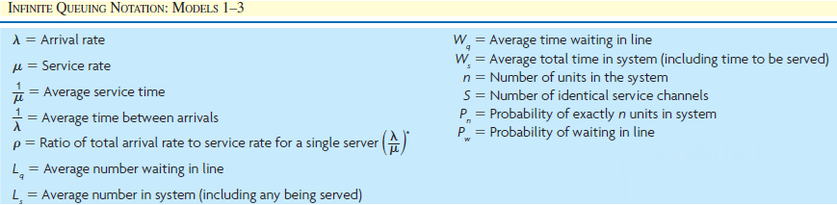
Queues (Outputs in Models)

Slide 19
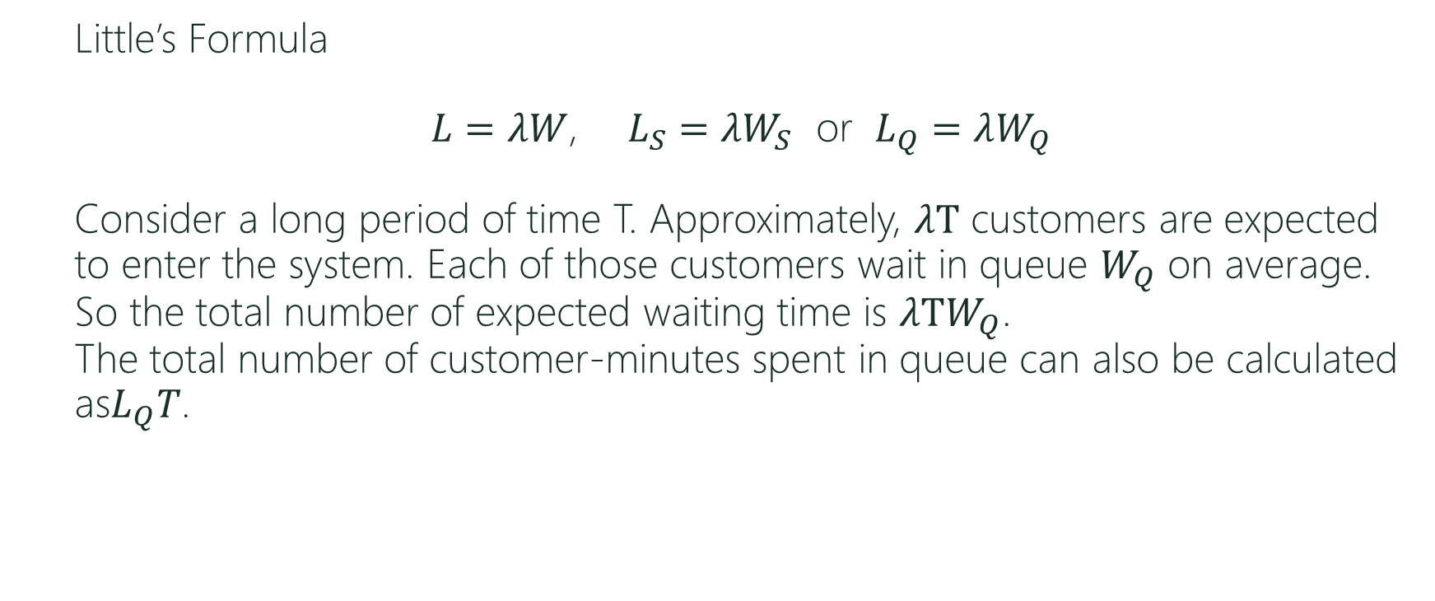
Queues (Relationships)
Little’s Formula
$L=λW$, $L_{S}=λW_{S}$ or $L_{Q}=λW_{Q}$
Consider a long period of time T. Approximately, $λT$ customers are expected to enter the system. Each of those customers wait in queue $W_{Q}$ on average. So the total number of expected waiting time is $λTW_{Q}$.
The total number of customer-minutes spent in queue can also be calculated as$L_{Q}T$.

Slide 20

Queues (Other Relationships)
Expected number of customers
$$L=\frac{ρ}{1−ρ}, L=L_{Q}+L_{S}$$
Expected time time spent in the system
$$W=W_{Q}+W_{S}$$
Server utilization
$$U=L_{S}/S$$

Slide 21
Queues (Kendall’s Notation)
A/B/C/K/M/Z
A -> describes the inter-arrival time probability distribution
B -> describes the service time probability distribution
C -> is the number of servers or channels
K -> is the space limit of the service facility in the sense that no more than K customers can be in the system (C in service and K - C waiting in queue)
M -> is the size of the customer population
Z ->is the queue discipline, i.e how the next customer is chosen from the queue when the server completes a service

Slide 22
Erlang Loss Model
The reason for the term loss is that there is no waiting room at all (no queue); customers who arrive when all servers are busy are lost to the system.
The steady-state distribution is specified by pn, 0 < n < s, where pn is the probability of exactly n customers in the system, and n cannot be greater than s because no queueing is allowed.
Notes:
Relationships can be found in practical management science page 681

Slide 23
Erlang Loss Model
The probability ps is of particular interest because it is the probability that all s servers are busy, so it represents the fraction of arrivals that are lost to the system.
Therefore, the effective arrival rate - the rate at which customers actually enter the system - is λ(1 – p_{s}), the usual arrival rate multiplied by the probability that an arrival is able to enter the system.
Notes:
Relationships can be found in practical management science page 681

Slide 24
Single-Server Model (MM1) (Memoryless, Memoryless,1 server, inf, inf, FCFS)
A fast-food restaurant has one drive-through window. On average, 40 customers arrive per hour at the window. It takes an average of one minute to serve a customer. Assume the interarrival and service times are exponentially distributed.
On average, how many customers are waiting in line?
On average how long does a customer spend at the restaurant?
What fraction of the time are more than three cars in line?
Notes:
Relationships can be found in practical management science page 681

Slide 25
Single-Server Model (MM1) (Memoryless, Memoryless,1 server, inf, inf, FCFS)
A local CVS is trying to decide how many cash registers to keep open.
Suppose an average of 18 customers arrive each hour, and the average
checkout time for a customer is four minutes.
Interarrival times and service times are exponentially distributed,
and the system can be modeled as an M/M/s system.
It costs $20 per hour to operate a cash register, and a cost of $0.25
is assessed for each minute the customer spends in the queue.
How many registers should the store open to minimize the expected hourly cost?

